Slide 1
Computer Simulation and Modeling
Random Number Generators

Slide 2
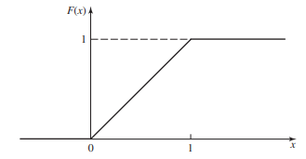
Properties of a Good Random-Number Generator
A “good” arithmetic random-number generator should possess several properties:
the numbers produced should appear to be distributed uniformly on [0, 1] and should not exhibit any correlation with each other.
From a practical standpoint, we would naturally like the
generator to be fast and avoid the need for a lot of storage.
We would like to be able to reproduce a given stream of
random numbers for debugging or verification of the
computer program easier.
There should be provision in the generator for easily producing separate “streams” of random numbers.
We would like the generator to be portable.

Slide 3
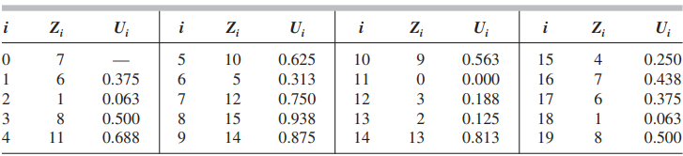
Linear Congruential Generators
A sequence of integers Z₁, Z₂, . . . is defined by the recursive formula
Z_{i} = (aZ_{i–1} + c)(mod m)
where m (the modulus), a (the multiplier), c (the increment), and Z₀ (the seed) are nonnegative integers.
As Z_{i} is the remainder of the above equation, we can say 0 ≤ Z_{i} ≤ m – 1
To obtain the desired random numbers U_{i} (for i = 1, 2, . . . ) on [0, 1], we let U_{i} = Z_{i} / m

Slide 4
Linear Congruential Generators
The LCG has full period if and only if the following three conditions hold:
The only positive integer that (exactly) divides both m and c is 1.
If q is a prime number (divisible by only itself and 1) that divides m, then q divides a – 1.
If 4 divides m, then 4 divides a – 1.

Slide 5
Exercise
Consider the LCG defined by m = 16, a = 5, c = 3, and Z₀ = 7
Find Z₅₀₀.

Slide 6
Computer Simulation and Modeling
Discrete Distribution

Slide 7
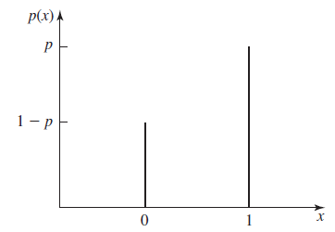

Bernoulli Random Variable
Has two possible outcomes: 0 or 1.
For a single coin toss, the probability you win one dollar is p. The random variable that represents your winnings after one coin toss is a Bernoulli random variable.
Possible applications: Used to generate other discrete random variates, e.g., binomial, geometric, and negative binomial.
p > 0.5

Slide 8
Binomial Distribution
If you toss the coin 5 times, your winnings could be any whole number of dollars from zero dollars to five dollars, inclusive.
The probability that you win five dollars is p⁵, because each coin toss is independent of the others, and for each coin toss the probability of heads is p.
Possible applications: Number of successes in t independent Bernoulli trials with probability p of success on each trial; number of “defective” items in a batch of size t; number of items in a batch (e.g., a group of people) of random size; number of items demanded from an inventory.

Slide 9
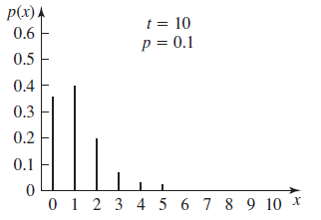
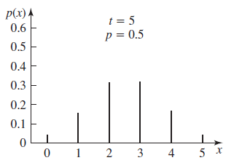
Binomial Distribution
What is the probability that you win exactly three dollars in five tosses?
probability ⁵C₃p³(1−p)².
A binomial random variable with parameter t = 1 is equivalent to a Bernoulli random variable, i.e. there is only one trial.

Slide 10

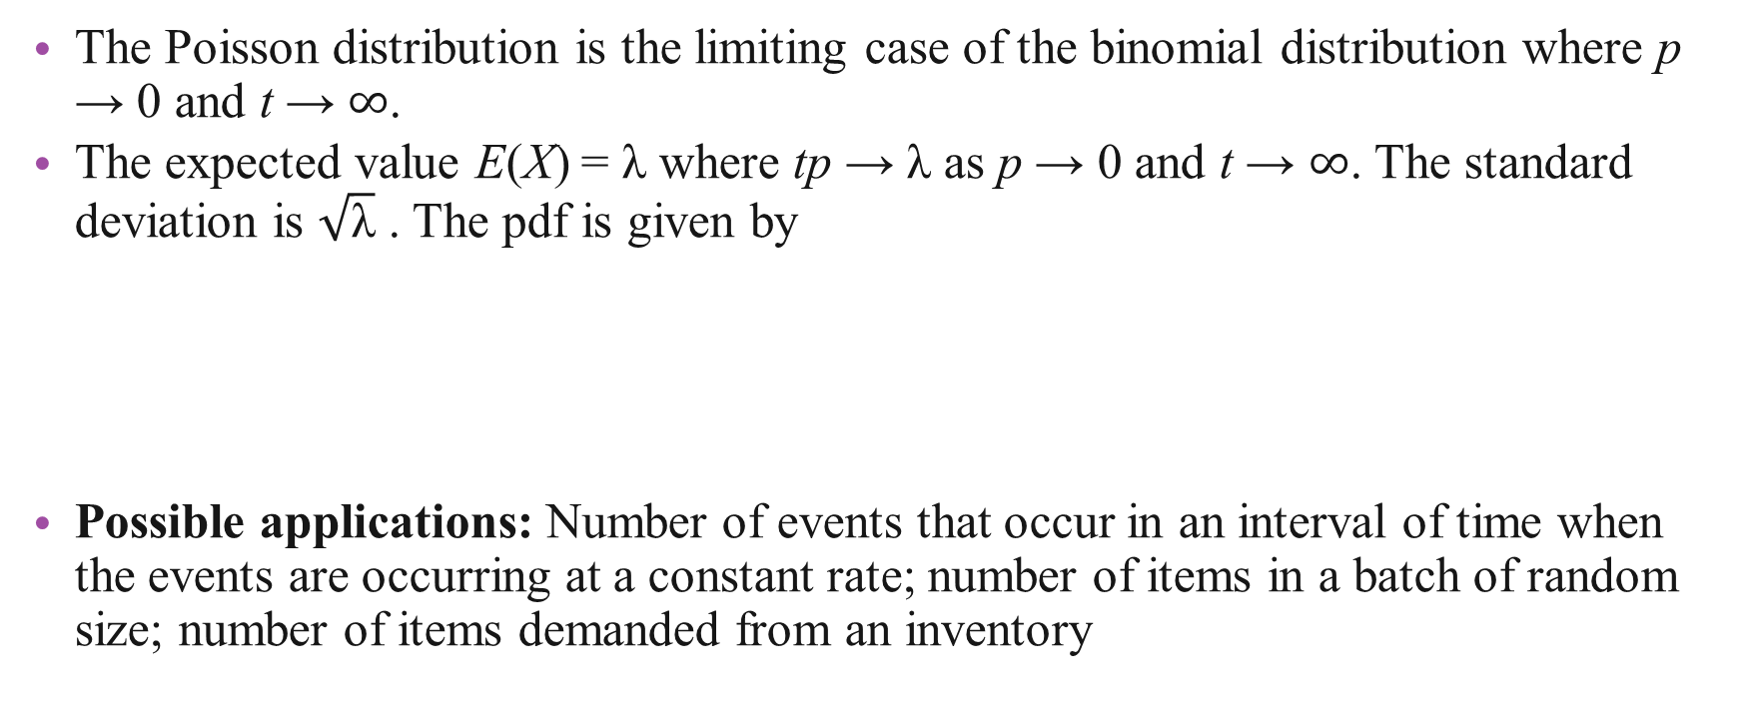
Poisson Distribution
The Poisson distribution is the limiting case of the binomial distribution where p → 0 and t → $∞$.
The expected value E(X) = λ where tp → λ as p → 0 and t → $∞$. The standard deviation is $\sqrt{\text{λ}}$ . The pdf is given by
Possible applications: Number of events that occur in an interval of time when the events are occurring at a constant rate; number of items in a batch of random size; number of items demanded from an inventory

Slide 11
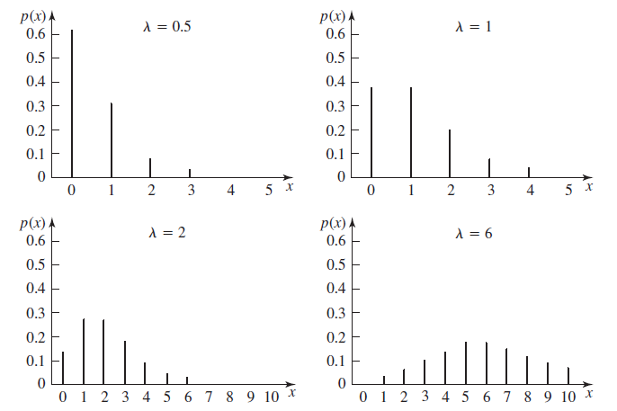
Poisson Distribution

